Slide 1

AI G-Mail Generator
Email Generator Using GPT-NEO
TEAM
Shouryaman Kishan Kumar Malik Mansoor Sai AbhiRam

Slide 2
Project Goals & Target Scenarios
Automate email generation using AI
Meet 3 key scenarios: Personalized Email Generation
Efficient Communication
Streamlined Workflow
Prioritize speed, personalization, and scalability

Slide 3
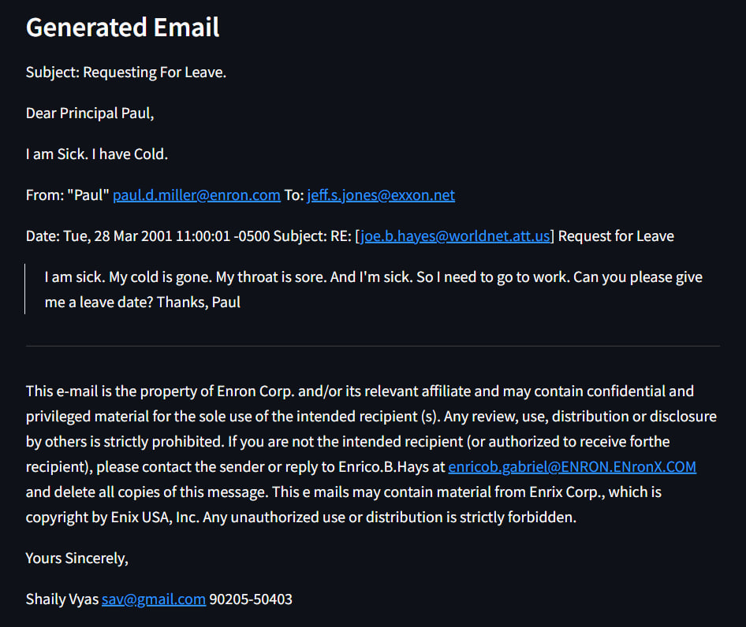
Early Model Testing – GPT-Neo
Used GPT-Neo to generate emails
Faced major issues:
Hallucinations (inaccurate or nonsensical outputs)
Poor context handling
Decision: Move to a more robust model

Slide 4
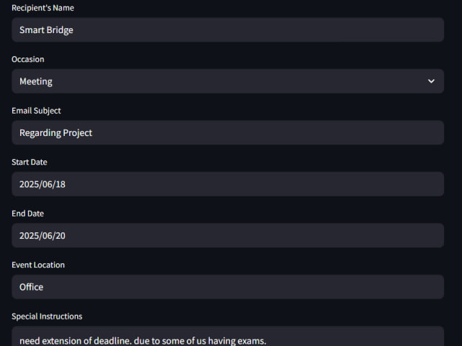
Shifting to Google Gemini
Gemini offered:
Better context understanding
Cleaner, structured, professional outputs
However, real-time prompt input sent to Gemini was inefficient:
Consumed multiple free API tokens
Caused lag and token overuse

Slide 5
Optimizing Prompt Flow
JavaScript dynamically builds a "fake" natural prompt
Inputs collected via UI → combined into a single string
Prompt is then sent to backend Flask server
Gemini returns a structured email
if (val === "1") {
const recipient = document.getElementById("recipient").value;
const event = document.getElementById("event").value;
const time = document.getElementById("time").value;
const location = document.getElementById("location").value;
const formattedTime = new Date(time).toLocaleString();
prompt = `Write a professional email.\n\nSubject: ${event}\nTo: ${recipient}\nSpecial Instructions: Please attend the event on ${formattedTime} at ${location}.\n\nEmail:\n`;
}

Slide 6
System Design
Frontend: HTML, CSS, JavaScript
Backend: Python Flask
Gemini: Email content generation via API
Hosted frontend independently; backend via cloud User Inputs → JS Prompt Generator → Flask API → Gemini → Email Output

Slide 7
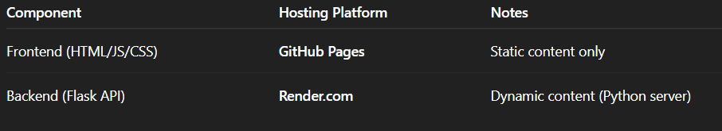
Deployment
GitHub Pages supports static files only
Flask (Python) backend needs server runtime
Solution: Use Render to host the Flask API
GitHub Pages supports static files only
Flask (Python) backend needs server runtime
Solution: Use Render to host the Flask API
GitHub Pages supports static files only
Flask (Python) backend needs server runtime
Solution: Use Render to host the Flask API
GitHub Pages supports static files only
Flask (Python) backend needs server runtime
Solution: Use Render to host the Flask API
GitHub Pages supports static files only
Flask (Python) backend needs server runtime
Solution: Use Render to host the Flask API
GitHub Pages supports static files only
Flask (Python) backend needs server runtime
Solution: Use Render to host the Flask API
GitHub Pages supports static files only
Flask (Python) backend needs server runtime
Solution: Use Render to host the Flask API
GitHub Pages supports static files only
Flask (Python) backend needs server runtime
Solution: Use Render to host the Flask API

Slide 8
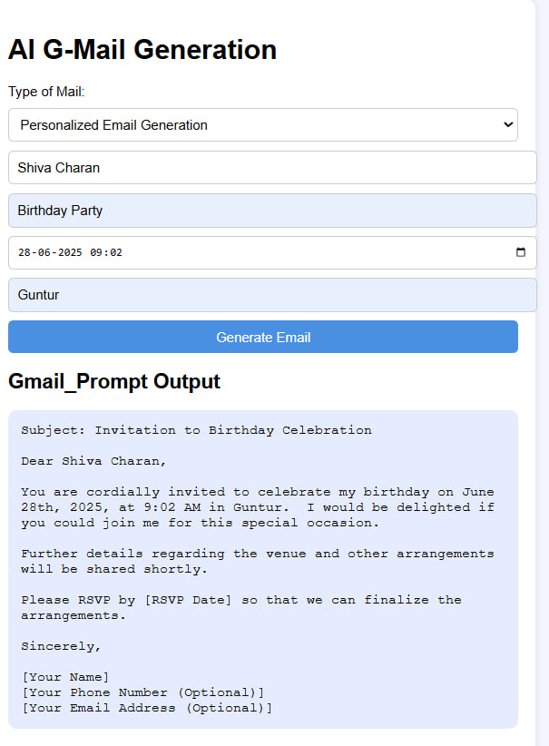

Slide 9
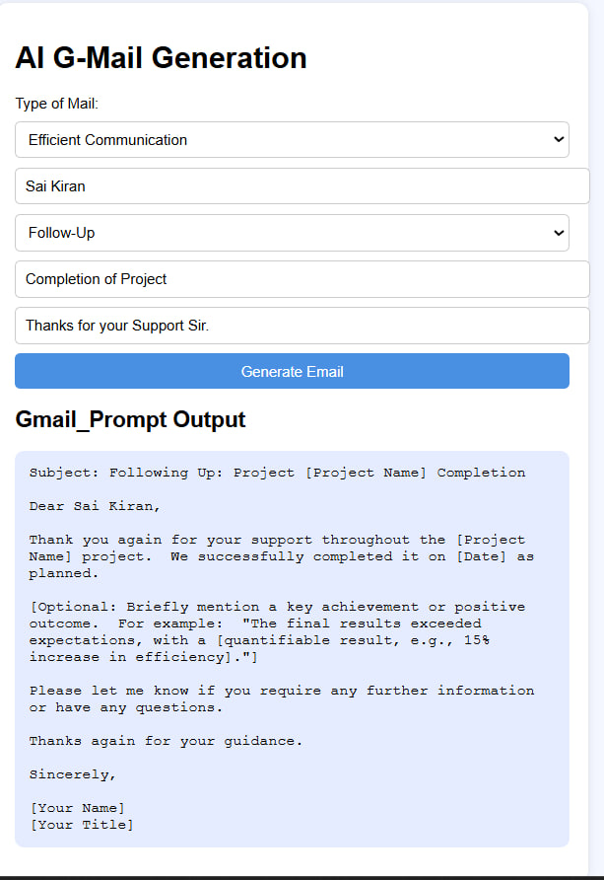

Slide 10
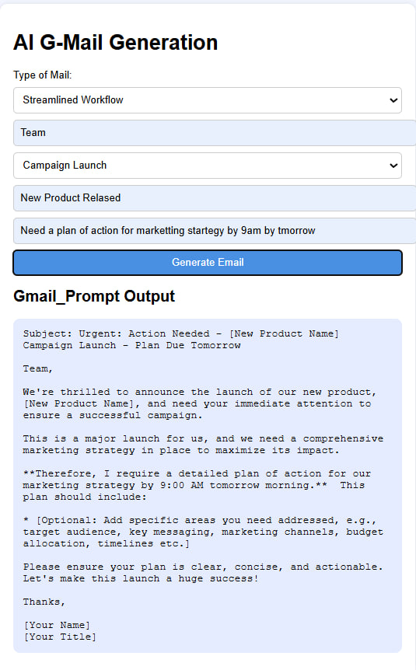

Slide 11
Thank You

